Slide 1
Social Media Sentiment Analysis with Explainable AI
Group no: 11
Shafin Mahmud Jalal (21266017)
Md. Rezuwan Hassan (21266014)
Pranto Protim Choudhury (21266023)
Fahmida Yesmin (21366012)
A.K.M. Salman Hosain (22166033)
Sifat Moonjerin (22173006/22166021)
Sabira Roshid Toma (19273002)

Slide 2
Introduction
Each language is accompanied with a feeling, which is referred to as a sentiment.
Sentiment analysis identifies the emotional tone behind a body of text.
Negative sentiments like hate, anger, jealousy or sadness has some adverse effect in our life.
Early recognition and treatment of negative sentiments minimizes the negative impact.
Twitter brings the world’s real-time events and the topics that people are currently discussing together.
This study aims to analysis sentiments behind the body of a text to identify whether the user has any negative sentiments or not, from the nature of his tweets and activity.
Presenter: Fahmida Yesmin (21366012)

Slide 3
Literature Review
H. Takkar et al. evaluated numerous lexical and machine learning techniques to analyze sentiment
I. Chaturvedi et al. determined the difference between views and facts during sentiment analysis
M. E. Mowlaei et al. analyzed user comments on several e-commerce sites
A. Hasan et al. conducted a comparison of sentiment analysers for twitter accounts using machine learning
K. H. Manguri et al. used the tweepy and TextBlob packages to analyze user data
G. A. Ruz et al. evaluated sentiment during critical occurrences using five classifiers
K. Sailunaz et al. created a recommendation system based on sentiment analysis of user tweets and responses
M. Danilevsky et al. performed a study to examine the use of Explainable AI in natural language processing
Sifat Moonjerin (22173006/22166021)

Slide 4
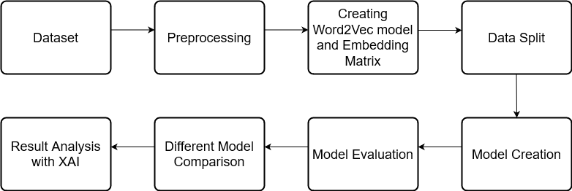
Methodology
Presenter: Pranto Protim Choudhury (21266023)

Slide 5
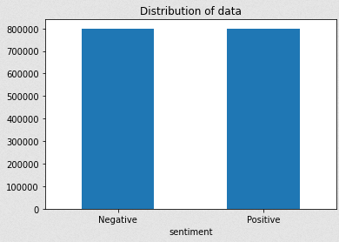
Methodology
1. Dataset
Utilized "sentiment140 dataset" from kaggle.
Re-mapped the labels.
Discarded the unnecessary fields.
Equally distributed the dataset.
Presenter: Pranto Protim Choudhury (21266023)

Slide 6
Methodology
2. Pre-processing
Regular expressions were used to remove all the user mentions, hashtags, urls, emojis, or symbols.
Normalization were done to make all the tokens lowercased.
A predetermined dictionary was utilized to replace all the non-alphabets with numbers and alphabets with spaces.
Tokenization was done using TensorFlow Tokenizer having input length of 60.
Padding was done using 'pad_sequences’ package from ’tensorflow.keras.preprocessing-sequence’
Stopwords were dropped.
Presenter: Pranto Protim Choudhury (21266023)

Slide 7
Methodology
Presenter: Md. Rezuwan Hassan (21266014)

Slide 8
Methodology
3. Creating embedding matrix
Utilized Word2Vec embedding.
Embedded dimension was set to 100.
4. Splitting data
Data was split into 3 sets
Training dataset contains 80% data
Validation dataset contains 10% data
Test dataset contains 10% data,
5. Model Creation
Used a hybrid architecture of CNN & Bi-LSTM layer.
Stacked 2 Bi-LSTM layers.
Trained the model using Tensorflow using 128 layers.
Presenter: Md. Rezuwan Hassan (21266014)

Slide 9
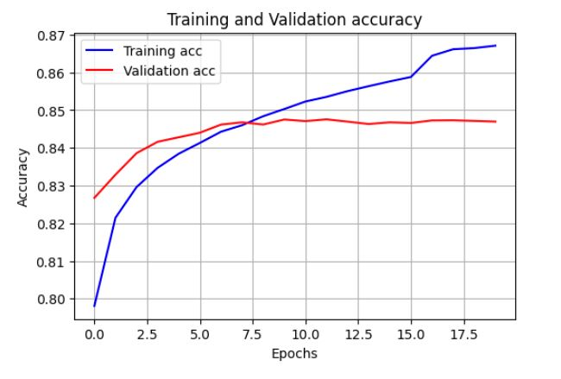
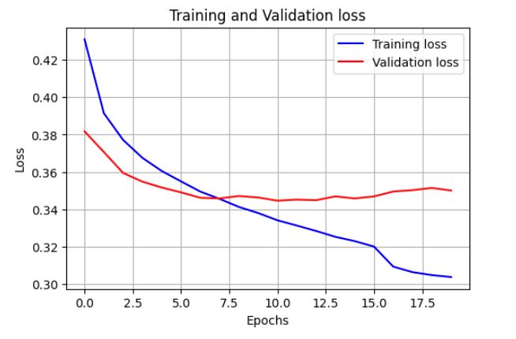
Result Analysis
Model Evaluation:
Presenter: Shafin Mahmud Jalal | ID: 21266017

Slide 10
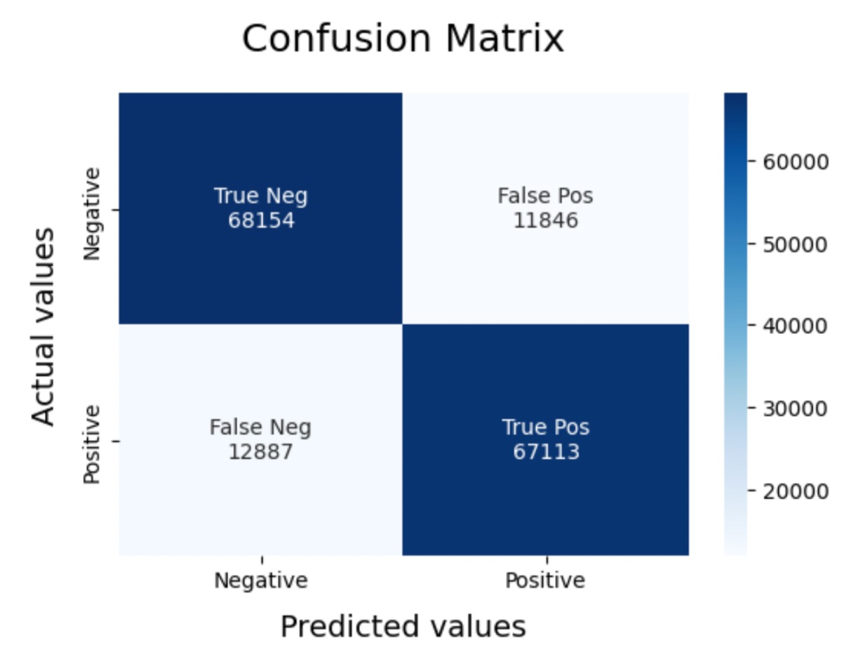
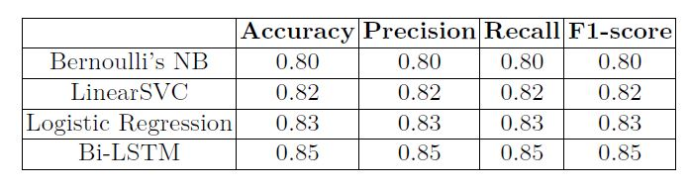
Result Analysis
Confusion Matrix and Different Model Comparison:
Presenter: Shafin Mahmud Jalal | ID: 21266017

Slide 11
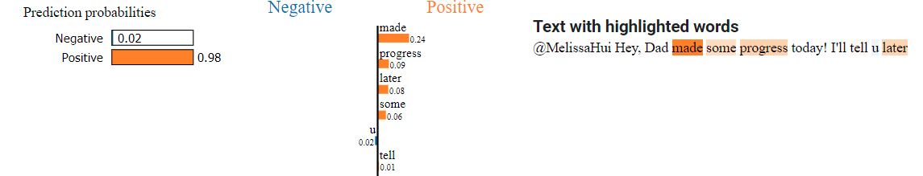
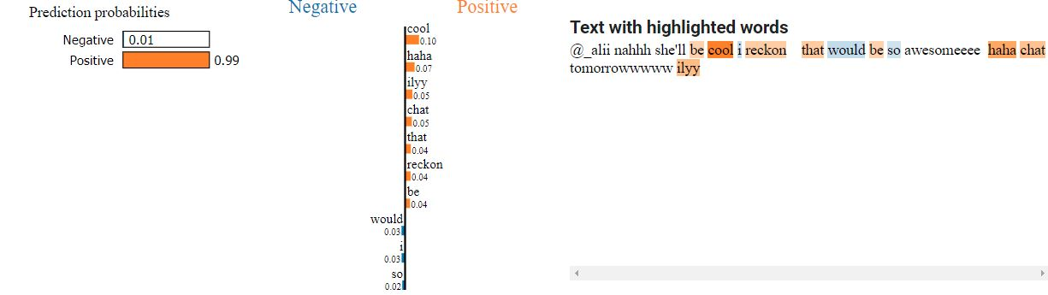
Result Analysis
Result Analysis with XAI:
Presenter: Shafin Mahmud Jalal | ID: 21266017

Slide 12
Conclusion and Future works
Bi-LSTM RNN framework based text-analyzing neural network model to detect depressive texts
1.6 million texts retrieved from social media platform
85% accuracy
Explainable Artificial Intelligence implementation
Lackings: Further preprocessing, incorrect labels,
Presenter: A.K.M Salman Hosain (22166033)

Slide 13
Thank You

